Slide 1
Chapter 12
Abstract
Data Type

Slide 2
OBJECTIVES
After reading this chapter, the reader should
be able to:
Understand the concept of an abstract data type (ADT).
Understand the concept of a linear list as well as its operations
and applications.
Understand the concept of a stack as well as its operations
and applications.
Understand the concept of a queue as well as its operations
and applications.
Understand the concept of a tree as well as its operations
and applications.
Understand the concept of a graph as well as its operations
and applications.

Slide 3
12.1
BACKGROUND

Slide 4
Don't Reinvent the Wheel!
Every software developer wants to create new and exciting stuff, but very often the same things are reinvented over and over again.

Slide 5

Separating
What and How
Note:
The concept of abstraction means:
1. You know what a data type can do.
2. How it is done is hidden.
Examples: read keyboar,read file,
C functions
bank queue,

Slide 6
ADT Definition
Note:
Abstract Data Type
Declaration of data
Declaration of operations
Encapsulation of data and operations and hide them from the user

Slide 7
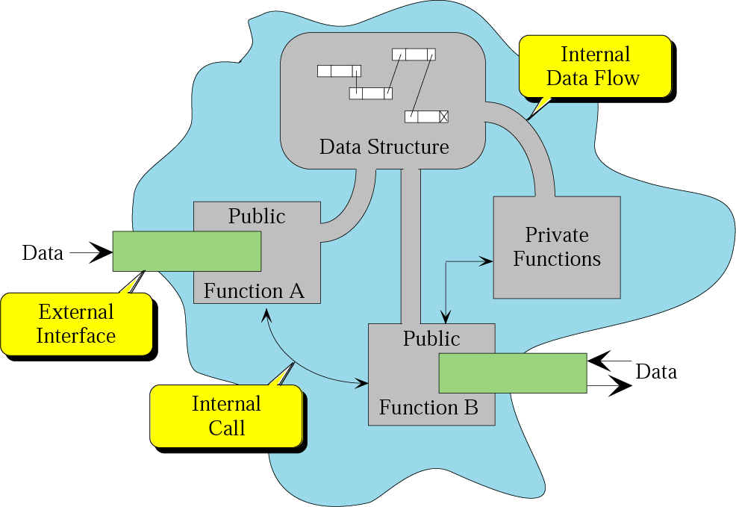
Model for ADT
Figure 12-1

Slide 8
Operations on ADTs
Operational Interface
Operational Interface
Figure 12-1

Slide 9
12.2
LINEAR
LISTS

Slide 10
Figure 12-2
Linear list
A linear list is a list in which each element has a unique successor.

Slide 11
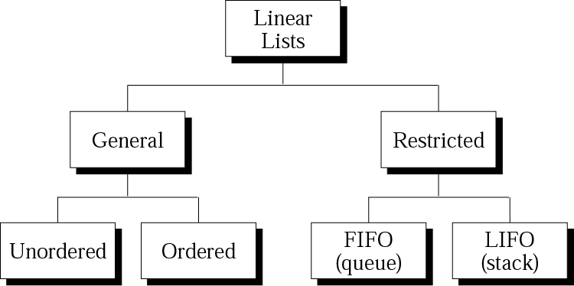
Figure 12-3
Categories of linear lists

Slide 12
Operations on linear lists
For general ordered linear lists
Insertion
Deletion
Retrieval
Traversal

Slide 13
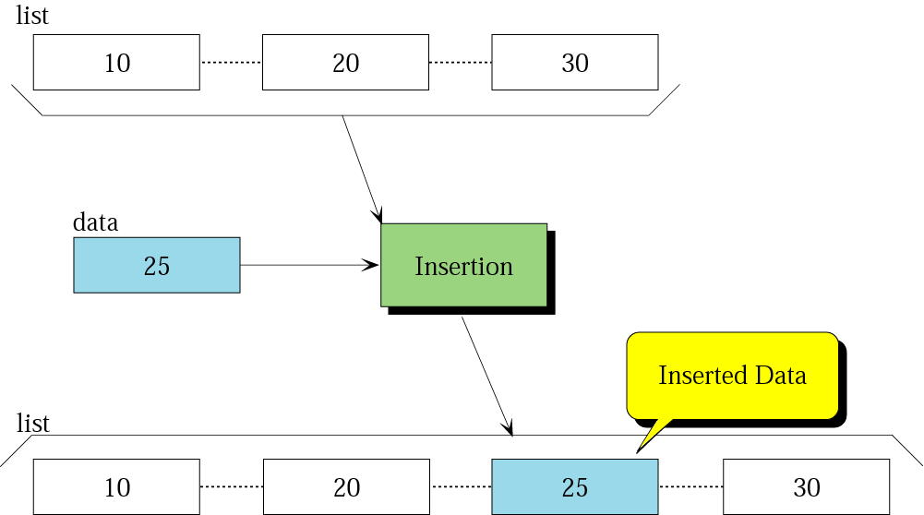
Figure 12-4
Insertion in a linear list

Slide 14
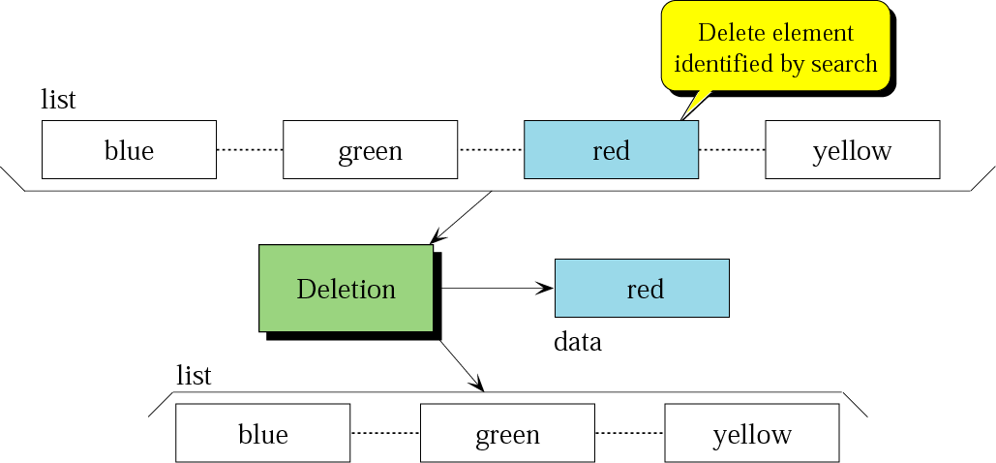
Figure 12-5
Deletion from a linear list

Slide 15
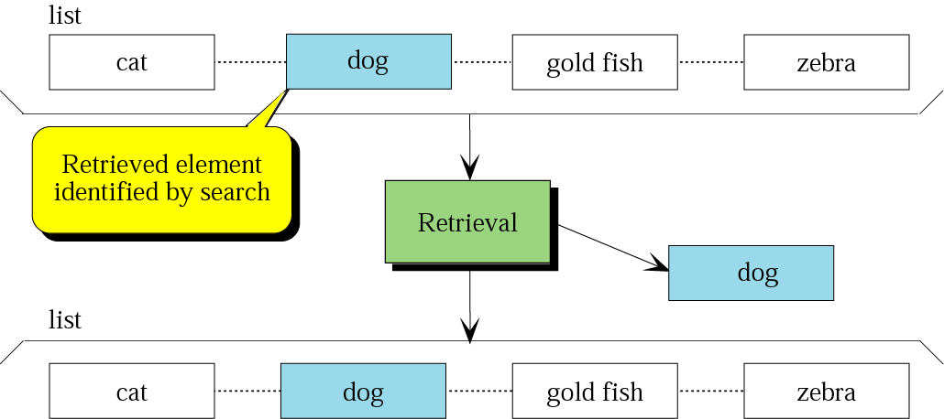
Figure 12-6
Retrieval from a linear list

Slide 16
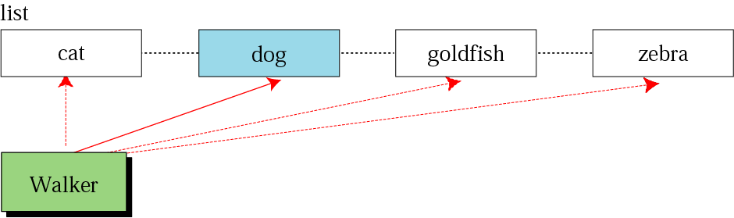
Figure 12-7
Traversal of a linear list

Slide 17
Implementation of a general linear list
Array
Linked list

Slide 18
Linear list application
Be used in situations where the elements are accessed randomly.
Students information in college

Slide 19
12.3
STACKS
A restricted linear list--LIFO

Slide 20
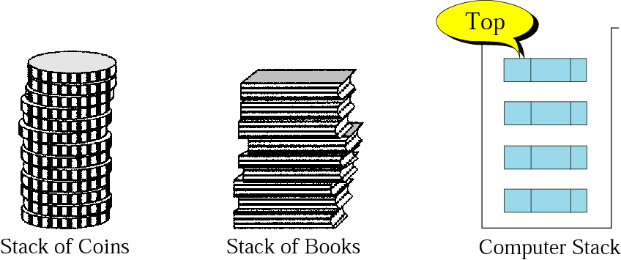
Three representations of a stack
Figure 12-8

Slide 21
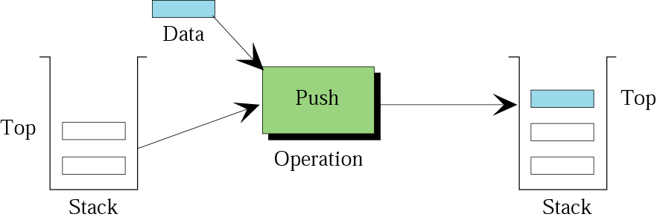
Figure 12-9
Push operation in a stack

Slide 22
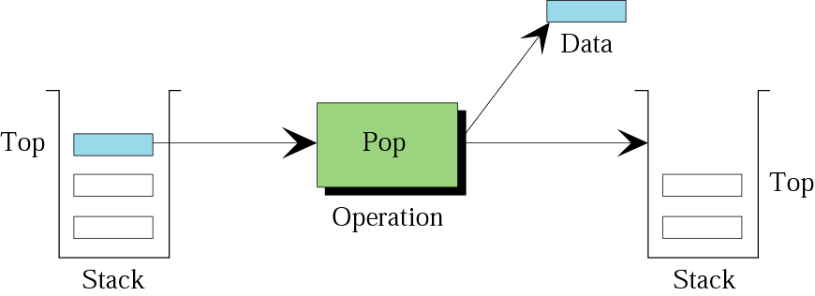
Figure 12-10
Pop operation in a stack

Slide 23
Figure 12-10
Empty operation in a stack
This operation checks to see if the stack is empty or not.
If not empty(S) then…

Slide 24
Example 1
Show the result of the following operations on a stack S.
push (S , 10)
push (S , 12)
push (S , 8)
if not empty (S), then pop (S)
push (S , 2)
Solution
See Figure 12.11 (next slide).

Slide 25
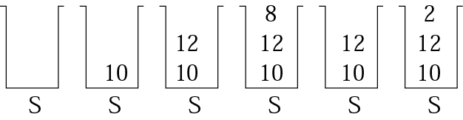
Figure 12-11
Example 1
push (S , 10)
push (S , 12)
push (S , 8)
if not empty (S), then pop (S)
push (S , 2)

Slide 26
Implementation of a stack
Array
Linked list

Slide 27
Stack applications
Reversing data
Parsing
Postponement
Backtracking

Slide 28
12.4
QUEUES
A restricted linear list--FIFO

Slide 29
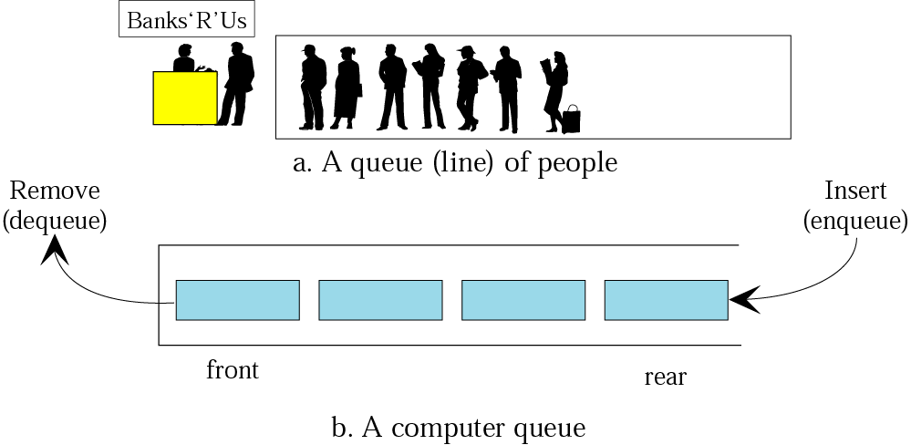
Figure 12-12
Queue representation

Slide 30
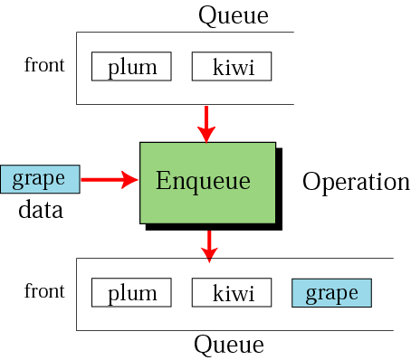
Figure 12-13
Enqueue operation

Slide 31
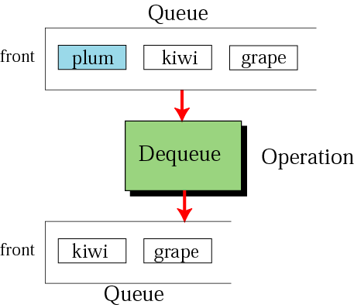
Figure 12-14
Dequeue operation

Slide 32
Example 2
Show the result of the following operations on a queue Q.
enqueue (Q , 23)
if not empty (Q), dequeue (Q)
enqueue (Q , 20)
enqueue (Q , 19)
if not empty (Q), dequeue (Q)
Solution
See Figure 12.15 (next slide).

Slide 33
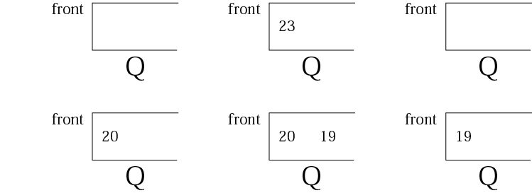
Figure 12-15
Example 2
enqueue (Q , 23)
if not empty (Q), dequeue (Q)
enqueue (Q , 20)
enqueue (Q , 19)
if not empty (Q), dequeue (Q)

Slide 34
12.5
TREES

Slide 35
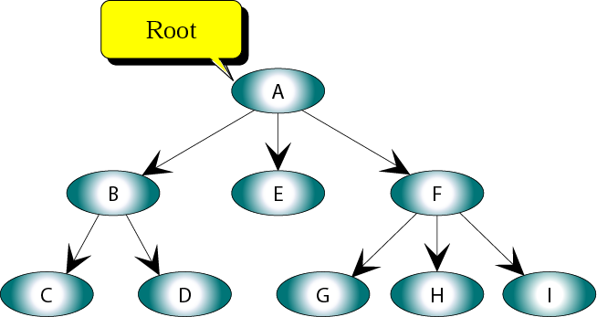
Figure 12-16
Representation of a tree

Slide 36
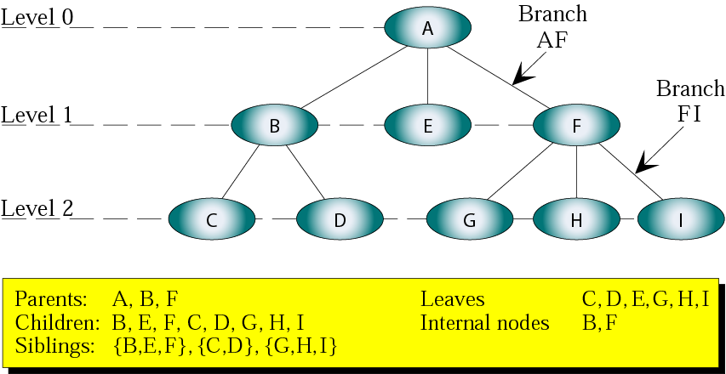
Figure 12-17
Tree terminology

Slide 37
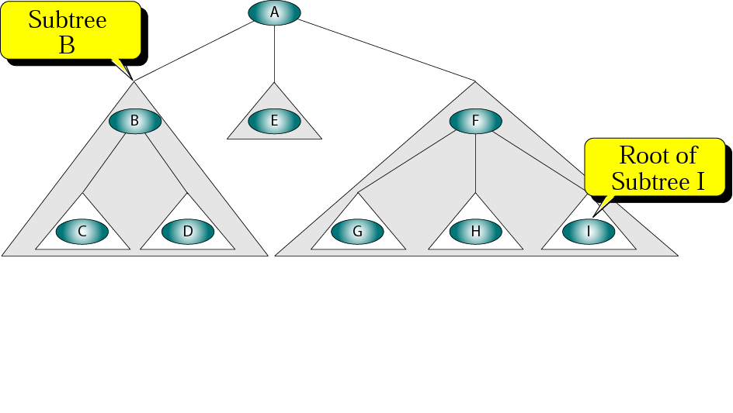
Figure 12-18
Subtrees

Slide 38
12.6
BINARY
TREES

Slide 39
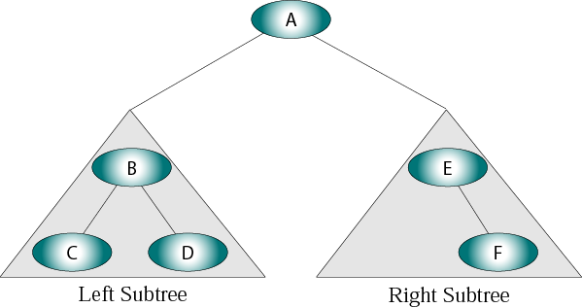
Figure 12-19
Binary tree

Slide 40
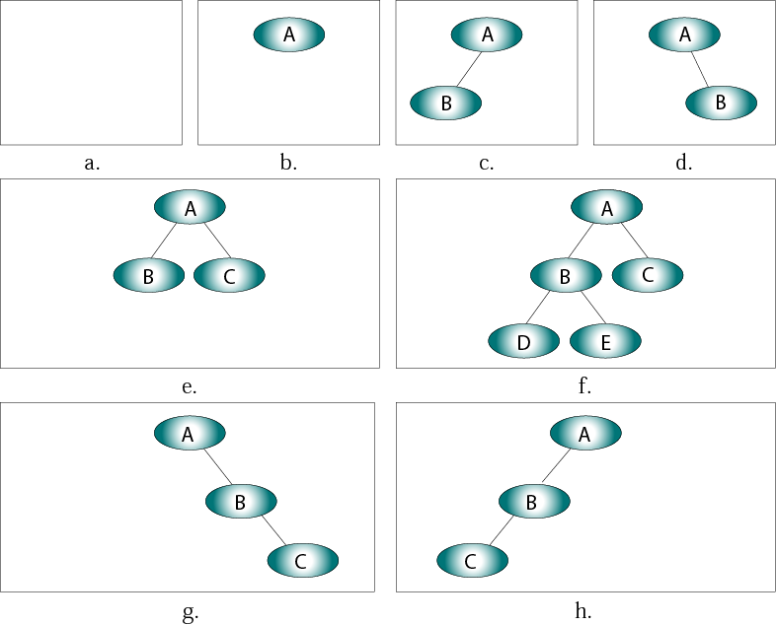
Figure 12-20
Examples of binary trees

Slide 41
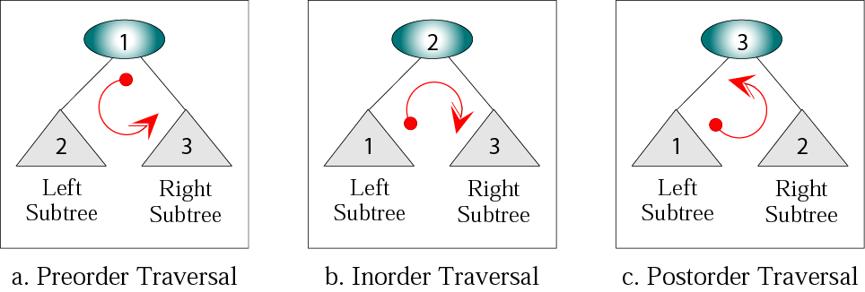
Figure 12-21
Depth-first traversal of a binary tree

Slide 42
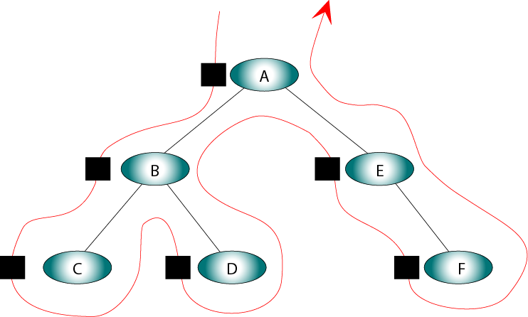
Figure 12-22
Preorder traversal of a binary tree

Slide 43
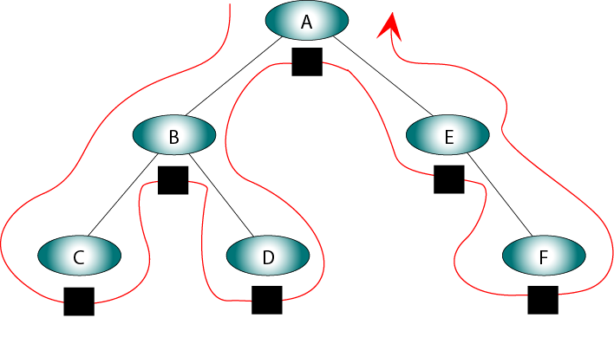
Figure 12-23
Inorder traversal of a binary tree

Slide 44
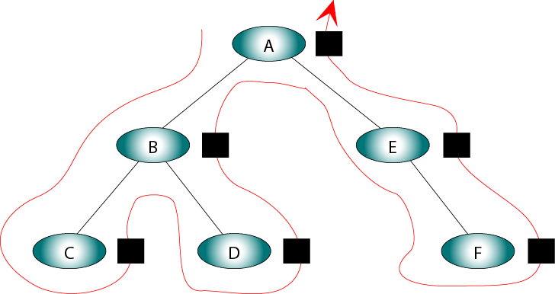
Figure 12-24
Postorder traversal of a binary tree

Slide 45
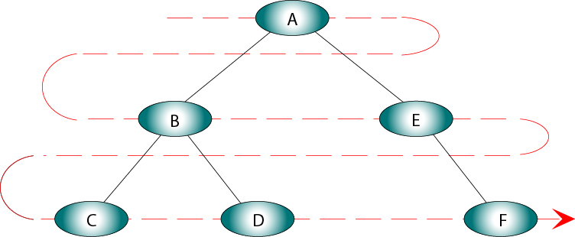
Figure 12-25
Breadth-first traversal of a binary tree

Slide 46
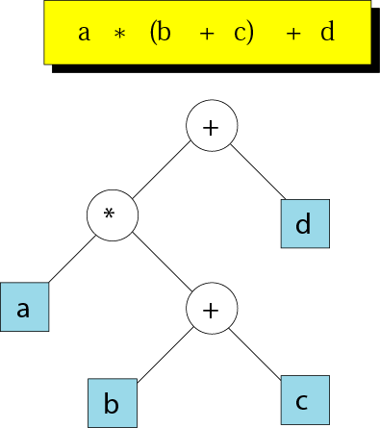
Figure 12-26
Expression tree

Slide 47
12.7
GRAPHS

Slide 48
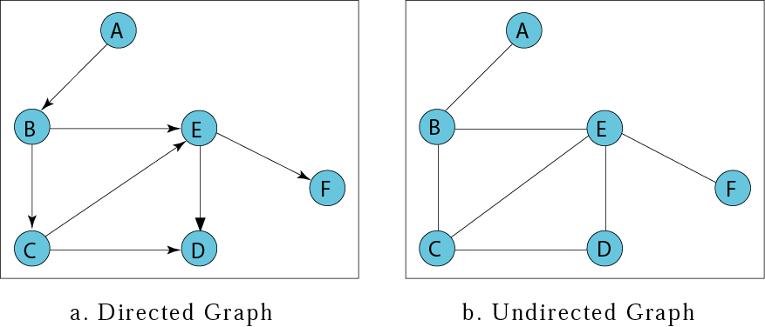
Figure 12-27
Directed and undirected graphs

Slide 49
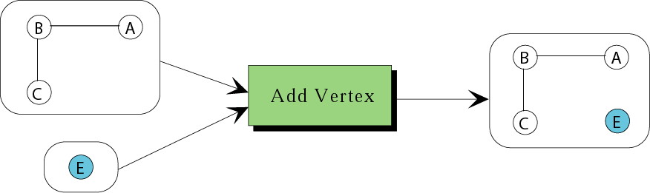
Figure 12-28
Add vertex

Slide 50
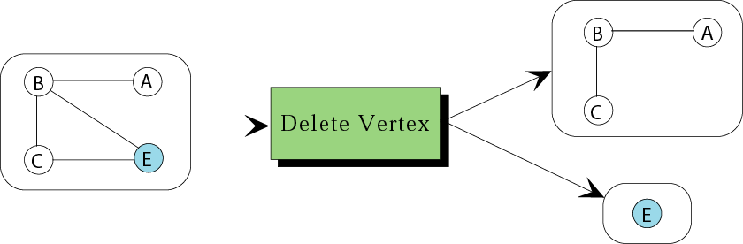
Figure 12-29
Delete vertex

Slide 51
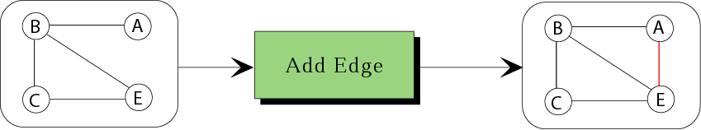
Figure 12-30
Add edge

Slide 52
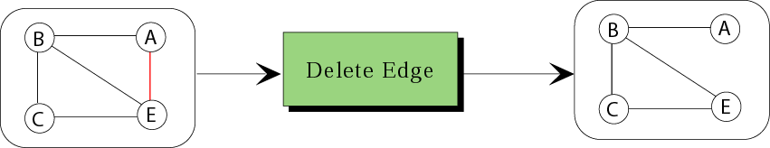
Figure 12-31
Delete edge

Slide 53
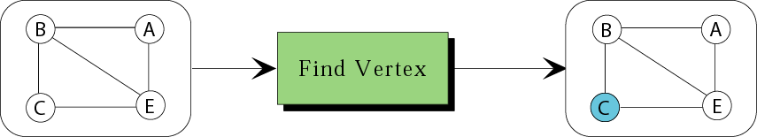
Figure 12-32
Find vertex

Slide 54
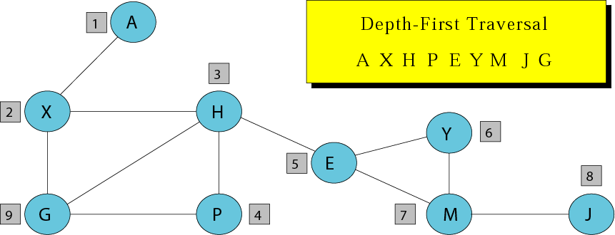
Figure 12-33
Depth-first traversal of a graph

Slide 55
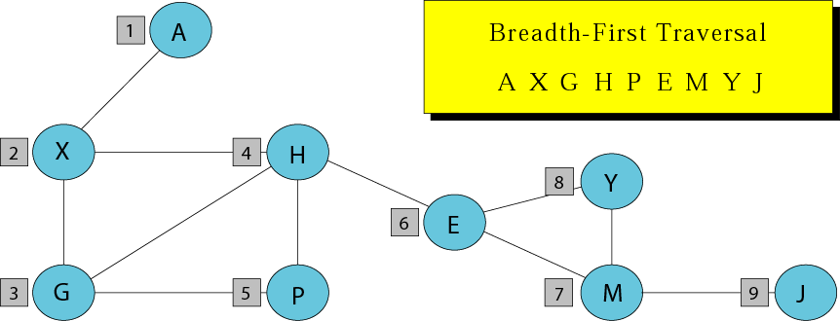
Figure 12-34
Breadth-first traversal of a graph

Slide 56
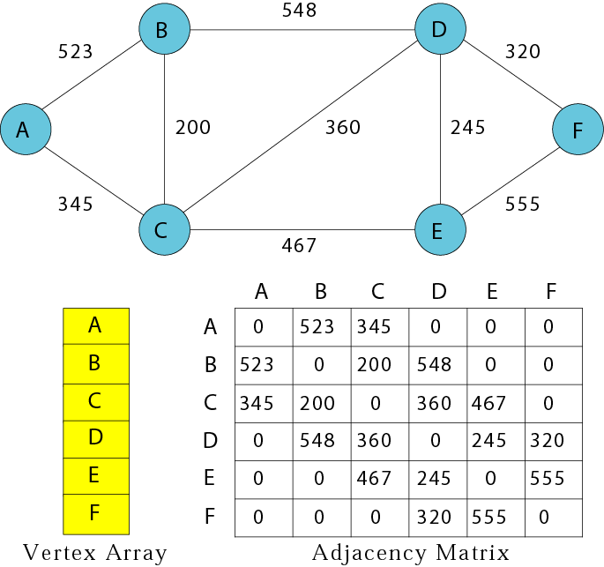
Figure 12-35: Part I
Graph implementations

Slide 57
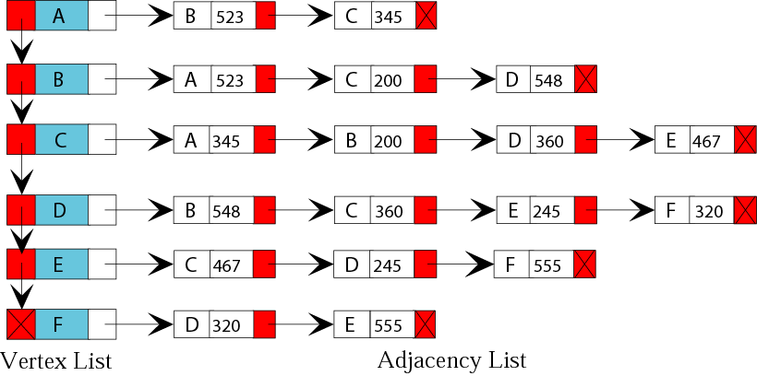
Figure 12-35: Part 2
Graph implementations

